Slide 1

6th Grade Accelerated Math
Unit 3, Lesson 2 Numbers and the Number Line – Part 2 Volume 1, pg. 82

Slide 2


Benchmark
MA.6.NSO.1.1
Extend previous understanding of numbers to define rational numbers. Plot, order, and compare rational numbers.
MA.6.NSO.1.2
Given a mathematical or real-world context, represent quantities that have opposite direction using rational numbers. Compare them on a number line and explain the meaning of zero within its context.
volume 1, pg. 82

Slide 3
Integrated Mathematical Thinking and Reasoning Standards
MA.K12.MTR.1.1 Actively participate in effortful learning both individually and collectively.
MA.K12.MTR.4.1 Engage in discussions that reflect on the mathematical thinking of self and others.
MA.K12.MTR.5.1 Use patterns and structure to help understand and connect mathematical concepts.
volume 1, pg. 82

Slide 4

Learning Targets
I can determine how far a number and its opposite are from zero.
I can represent a number and its opposite on a number line.
I can compare a quantity and its opposite on a horizontal or vertical line and explain the meaning of zero within the context.
volume 1, pg. 82

Slide 5

Warm-Up
volume 1, pg. 82

Slide 6
3.2.1 Warm-Up: Word Pairs
Up | Down
Left | Right
Clockwise | Counterclockwise
Increase | Decrease
Ebb | Flow
West | East
North | South
Gain | Lose
What do you notice about the pairs of words above?
How do you think this may be used in the study of mathematics?
volume 1, pg. 82

Slide 7

Activity
volume 1, pg. 83

Slide 8

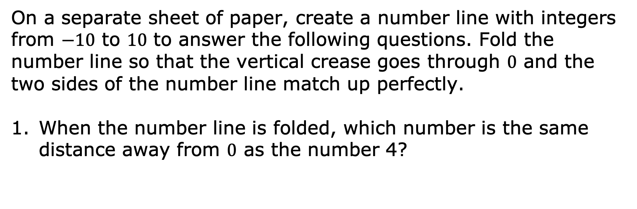
3.2.2 Activity: Folded Number Line
On a separate sheet of paper, create a number line with integers from $−10$ to $10$ to answer the following questions. Fold the number line so that the vertical crease goes through $0$ and the two sides of the number line match up perfectly.
When the number line is folded, which number is the same distance away from $0$ as the number 4?
volume 1, pg. 83

Slide 9
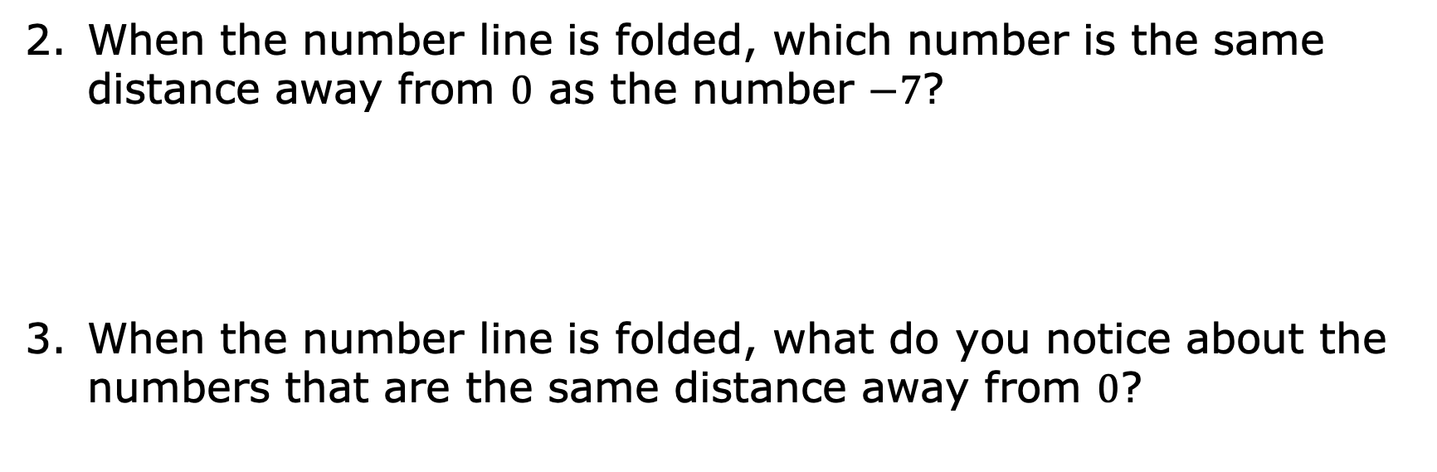
When the number line is folded, which number is the same distance away from $0$ as the number $−7$?
When the number line is folded, what do you notice about the numbers that are the same distance away from $0$?
volume 1, pg. 83

Slide 10

Find another pair of numbers that are the same distance away from $0$.
Two numbers that are the same distance from zero on the number line are called __________________.
volume 1, pg. 83

Slide 11

Collaboration
volume 1, pg. 83

Slide 12

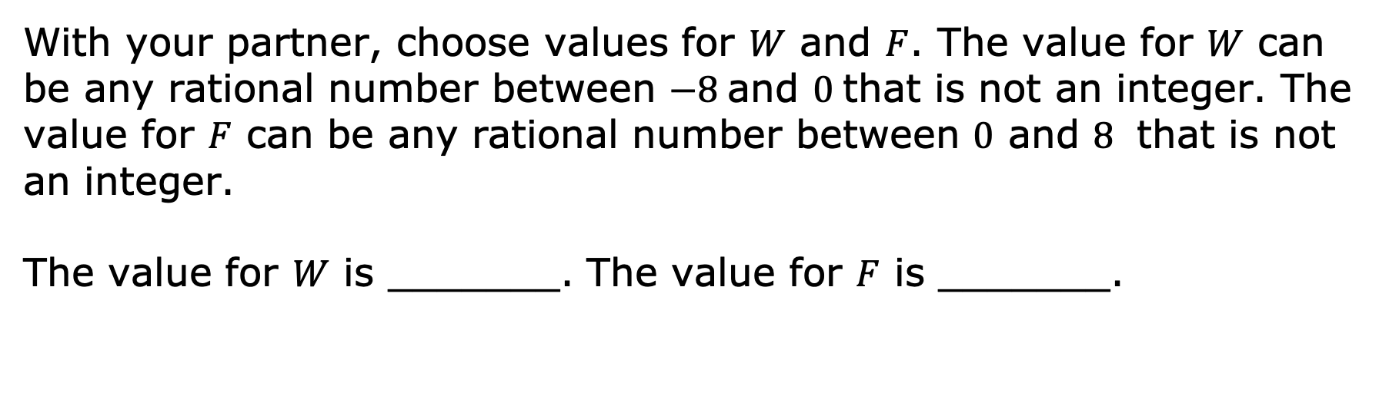
3.2.3 Collaboration: Opposites
With your partner, choose values for $W$ and $F$. The value for $W$ can be any rational number between $−8$and $0$that is not an integer. The value for $F$ can be any rational number between $0$ and $8$ that is not an integer.
The value for $W$ is _______. The value for $F$ is _______.
volume 1, pg. 83

Slide 13
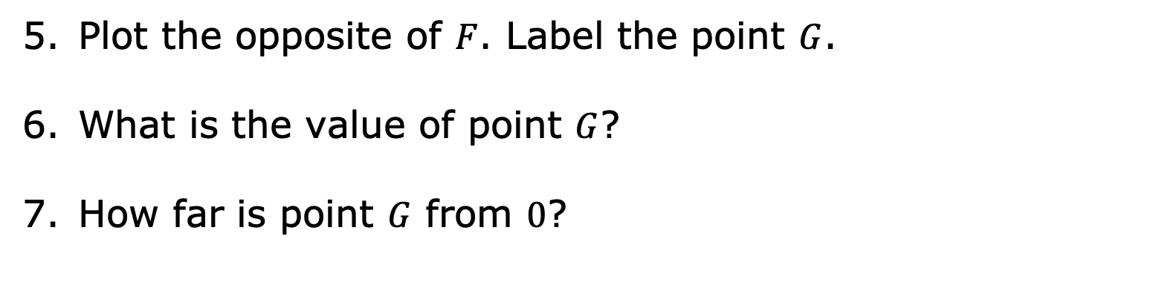
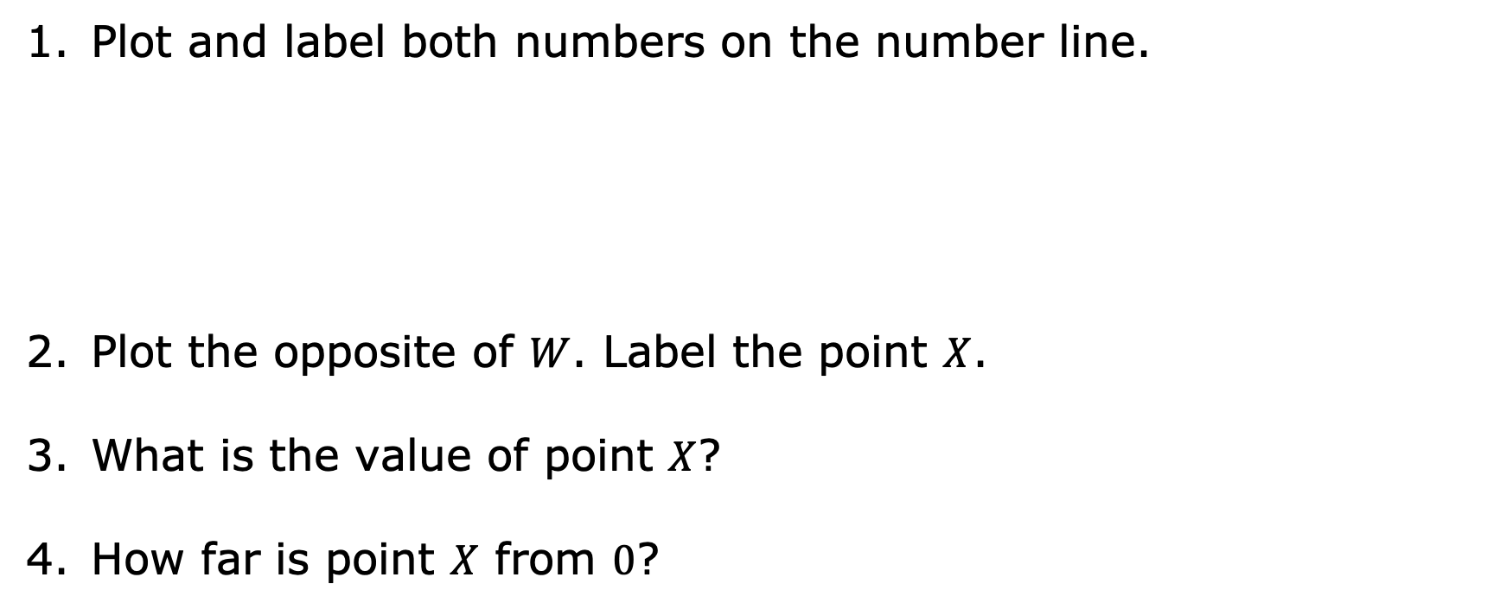
Plot and label both numbers on the number line.
Plot the opposite of $W$. Label the point $X$.
What is the value of point $X$?
How far is point $X$ from $0$?
Plot the opposite of $F$. Label the point $G$.
What is the value of point $G$?
How far is point $G$ from $0$?
volume 1, pg. 83

Slide 14
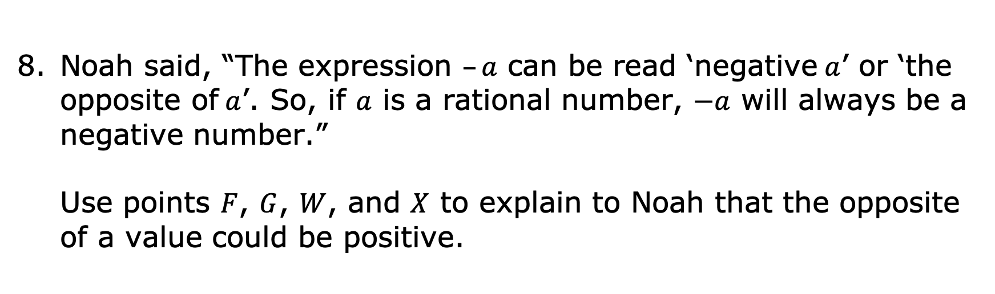
Noah said, “The expression $–a$ can be read ‘negative$a$’ or ‘the opposite of$a$’. So, if $a$ is a rational number, $−a$ will always be a negative number.”
Use points $F$, $G$, $W$, and $X$ to explain to Noah that the opposite of a value could be positive.
volume 1, pg. 84

Slide 15

Try It
volume 1, pg. 84

Slide 16

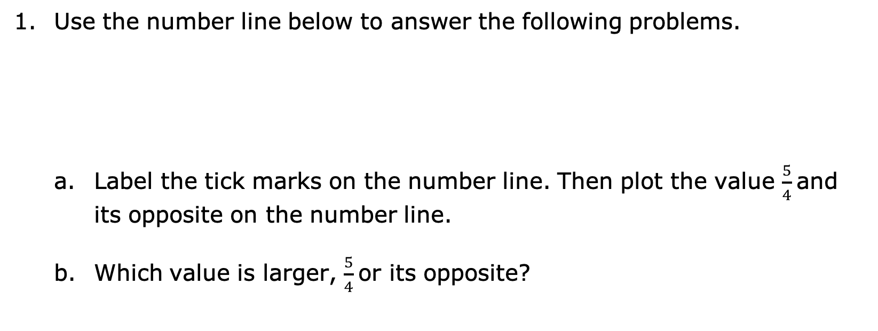
3.2.4 Try It: Opposites
Use the number line below to answer the following problems.
Label the tick marks on the number line. Then plot the value $\frac{5}{4}$and its opposite on the number line.
Which value is larger, $\frac{5}{4}$or its opposite?
-5
0
5
volume 1, pg. 84

Slide 17
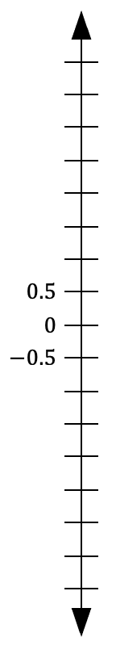
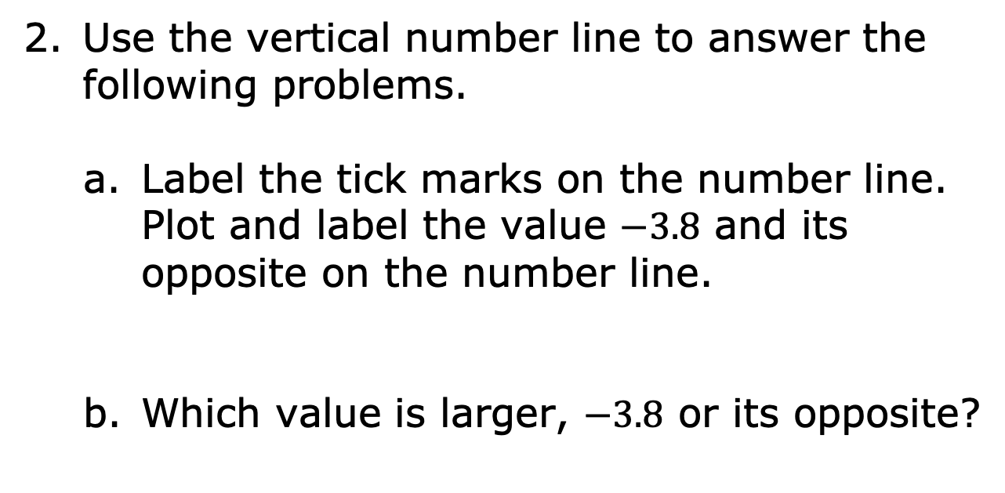
Use the vertical number line to answer the following problems.
Label the tick marks on the number line. Plot and label the value $−3.8$ and its opposite on the number line.
Which value is larger, $−3.8$ or its opposite?
volume 1, pg. 84

Slide 18

Guided Instruction
volume 1, pg. 85

Slide 19
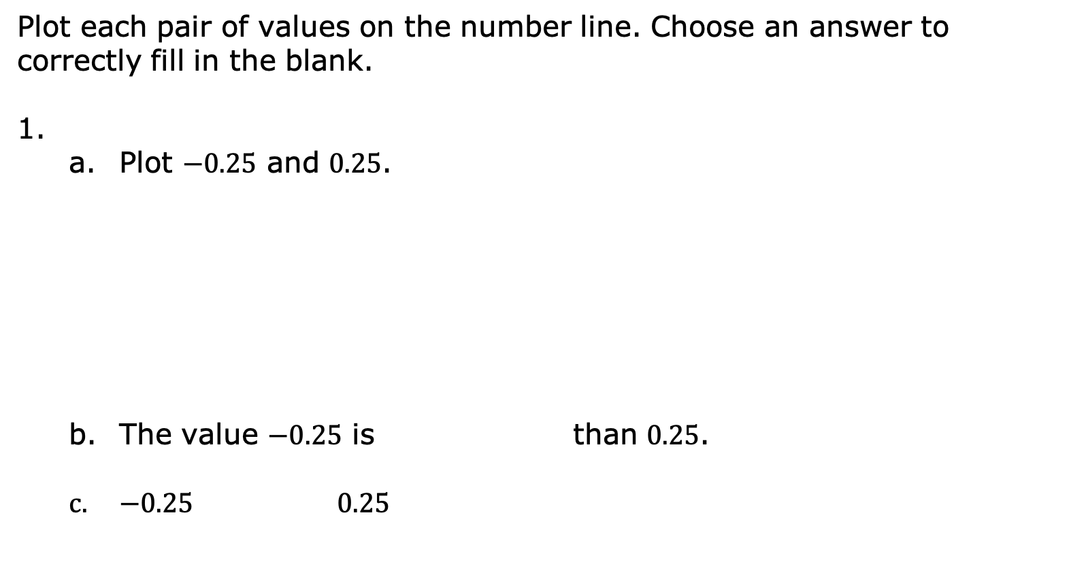
3.2.5 Guided Instruction: Comparing a Quantity and Its Opposite
Plot each pair of values on the number line. Choose an answer to correctly fill in the blank.
Plot $−0.25$ and $0.25$.
The value $−0.25$ is than $0.25$.
$−0.25$ $0.25$
-1
0
1
greater
less
>
<
volume 1, pg. 85

Slide 20
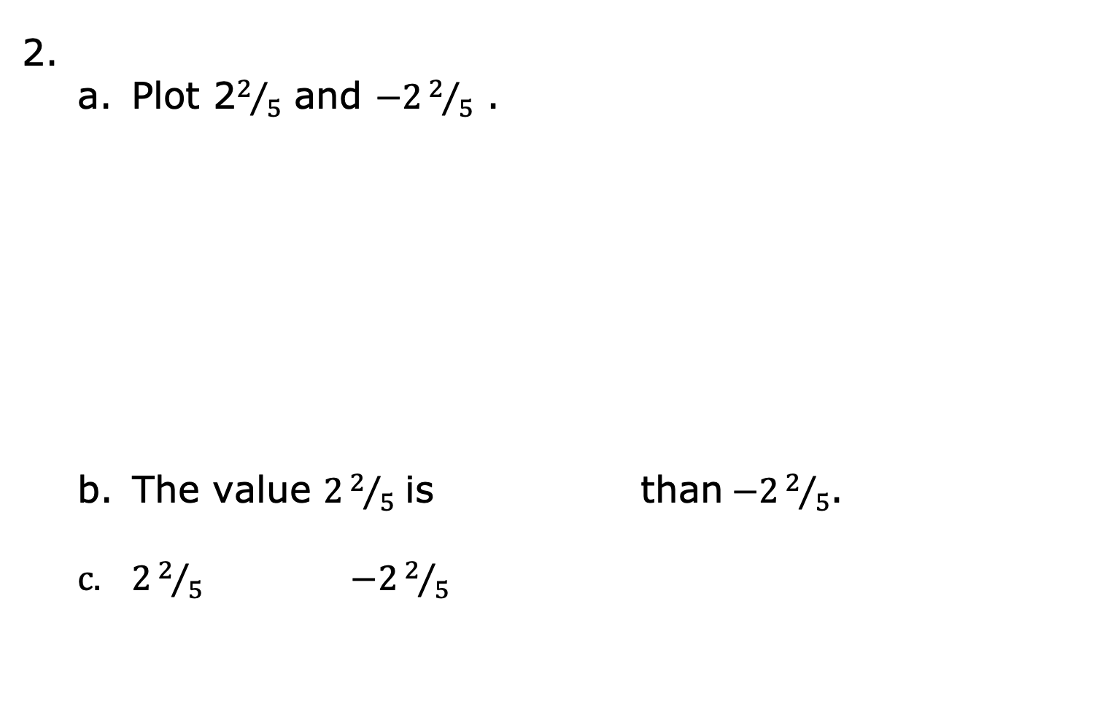
Plot 2$2/5$ and $−22/5$ .
The value $22/5$ is than$−22/5$.
$22/5$ $−22/5$
-1
0
1
greater
less
>
<
volume 1, pg. 85

Slide 21
In each comparison, the number on a horizontal
number line that is farther to the is the
greater value.
When comparing opposites, the value
will always be the greater value.
right
left
positive
negative
volume 1, pg. 85

Slide 22

Your Turn
volume 1, pg. 86

Slide 23
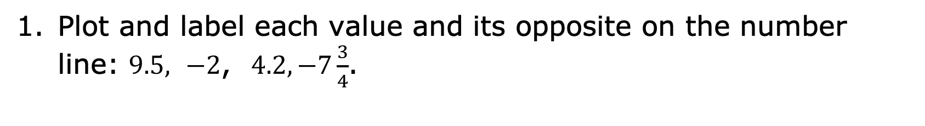
3.2.6 Your Turn!
Plot and label each value and its opposite on the number line: $9.5,$ $−2$, $4.2, −7\frac{3}{4}$.
volume 1, pg. 86

Slide 24
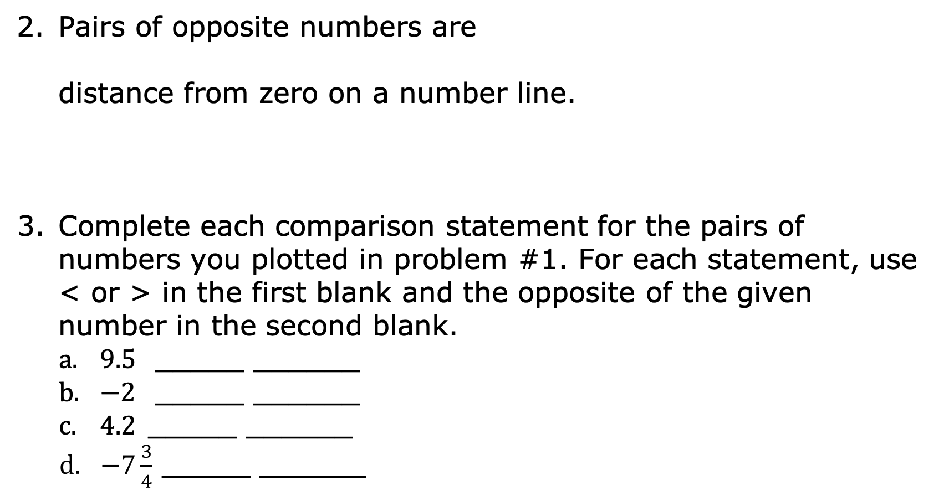
the same
a different
Pairs of opposite numbers are
distance from zero on a number line.
Complete each comparison statement for the pairs of numbers you plotted in problem #1. For each statement, use < or > in the first blank and the opposite of the given number in the second blank.
$9.5$ _____ ______
$−2$ _____ ______
$4.2$_____ ______
$−7\frac{3}{4}$ _____ ______
volume 1, pg. 86

Slide 25

Wrap-Up
volume 1, pg. 86

Slide 26
3.2.7 Wrap-Up: Cool Down
What is the relationship between a number and its opposite? Use the words number line and zero in your explanation.
volume 1, pg. 86

